Slide 1
Databases
Relational Databases and RDBMS

Slide 2
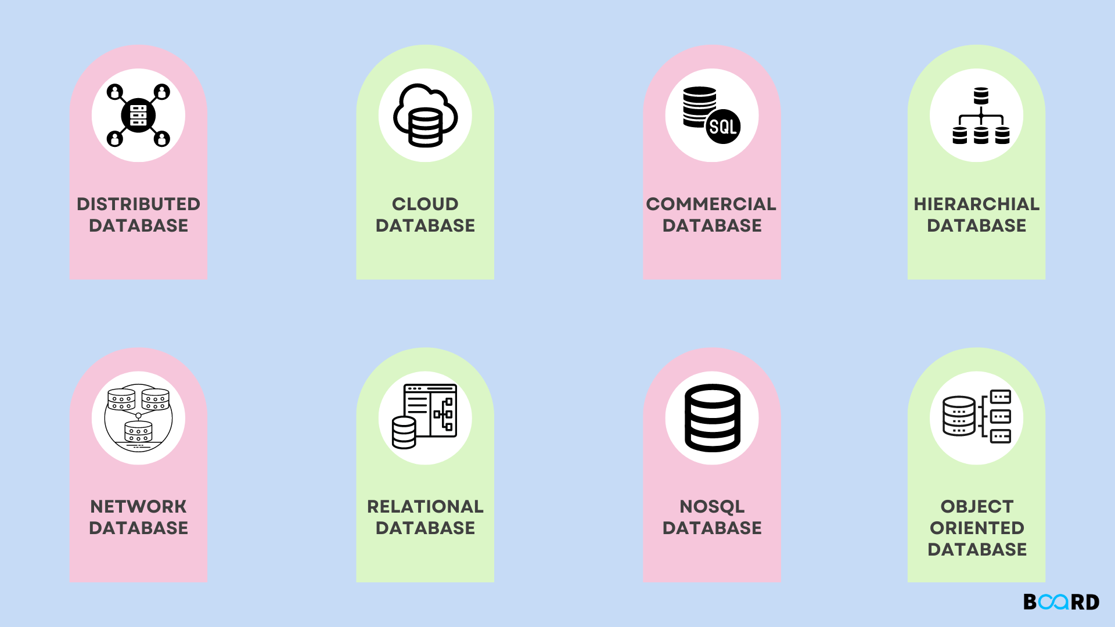
Database
organized collection of data
managed by DBMS
stored on RAM, a file system, a computer cluster or a cloud storage

Slide 3
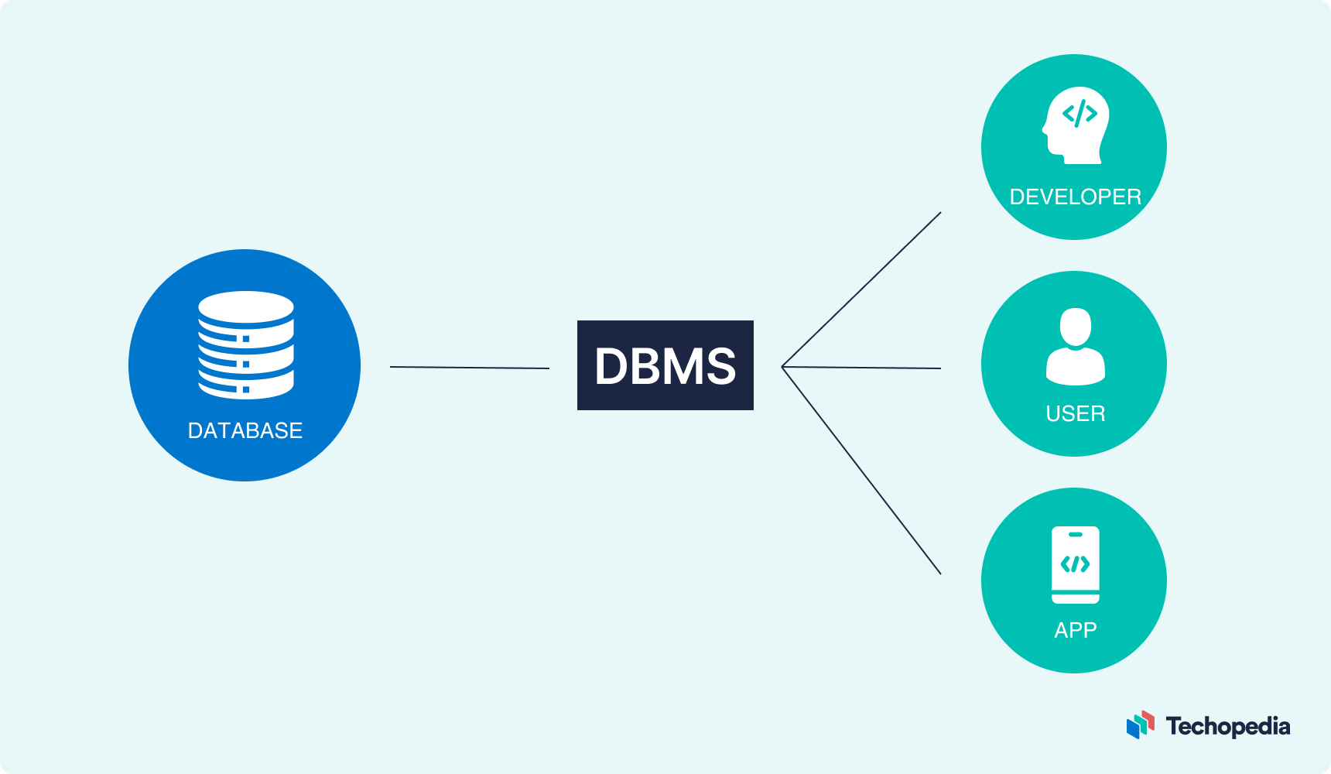
DBMS
Data storage, retrieval and update
User accessible catalog or data dictionary describing the metadata
Support for transactions and concurrency
Facilities for recovering the database should it become damaged
Support for authorization of access and update of data
Access support from remote locations
Enforcing constraints to ensure data in the database abides by certain rules

Slide 4
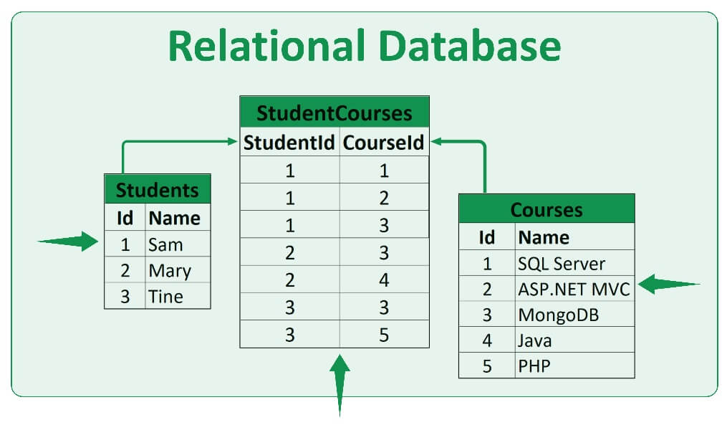
Relational Database (RDBMS)
Definition:
Consists of rows and columns
Implements relations between data
Tables has primary and foreign keys

Slide 5
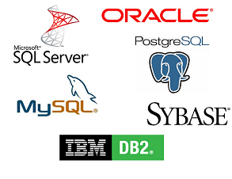
Relational Database (RDBMS)
Advantages:
Data Integrity
Flexibility
Data Security
Scalability
Data Querying

Slide 6
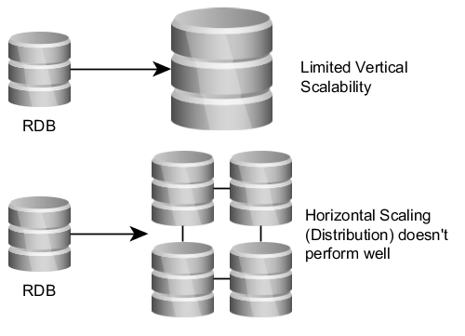
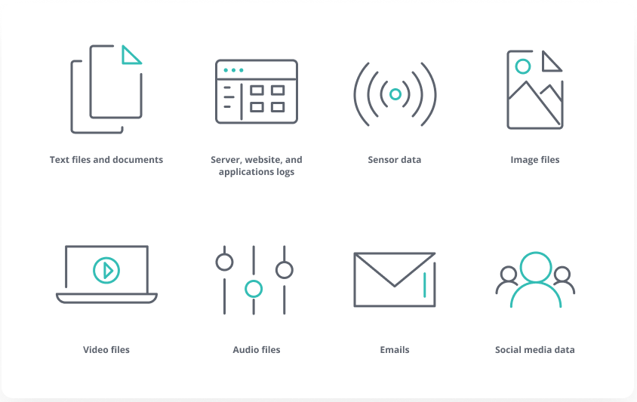
Relational Database (RDBMS)
Disadvantages:
Performance
Schema Mutability
Horizontal Scalability
Not Suitable for Unstructured Data

Slide 7
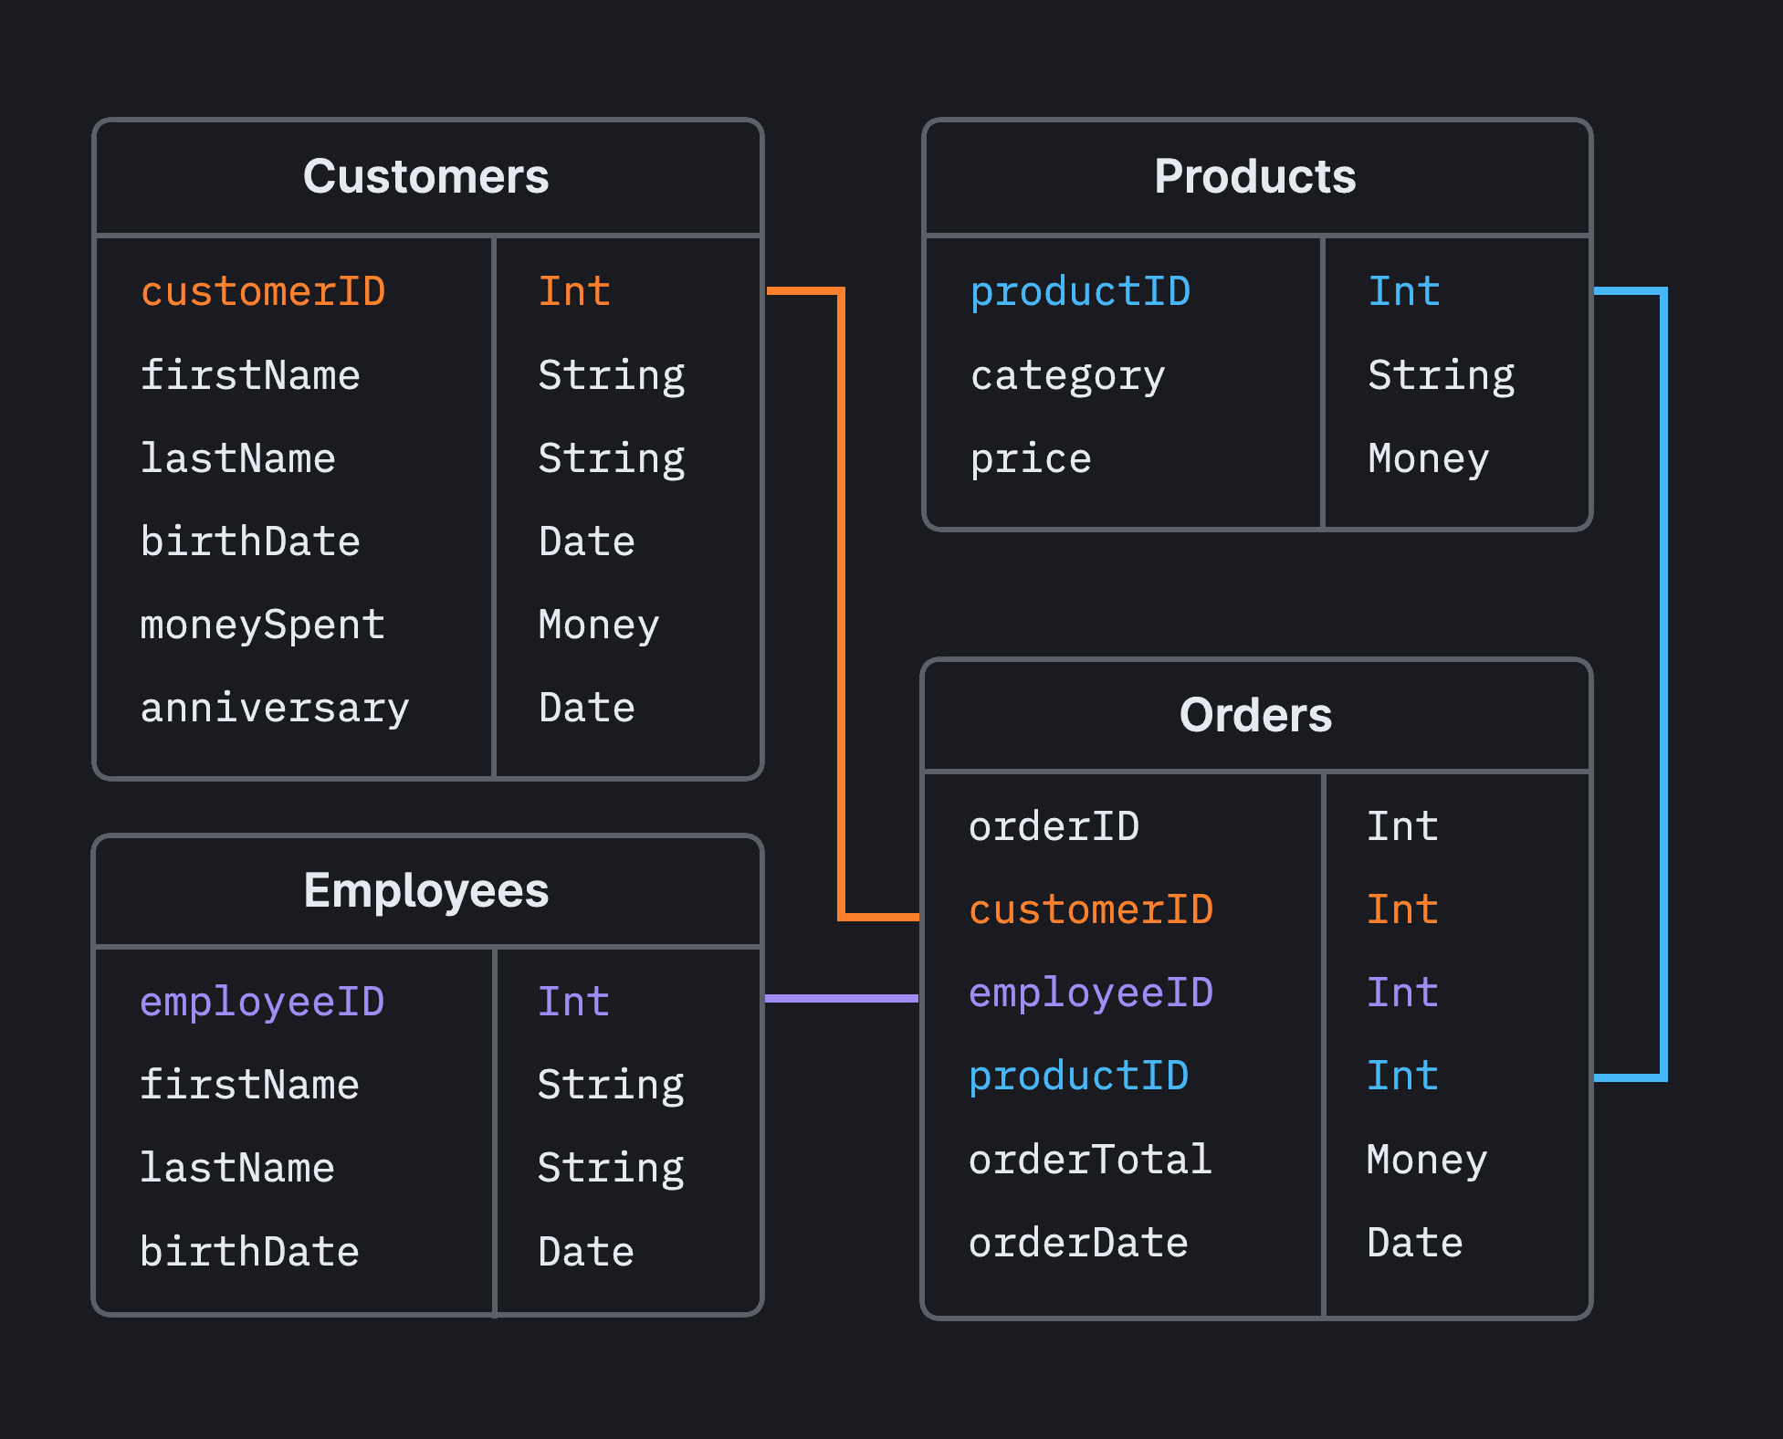
RDBMS Structure
Schema
Tables
Rows and Columns
Primary and Foreign Keys
Relationships:
one-to-one
one-to-many
many-to-many
Indices
Views

Slide 8
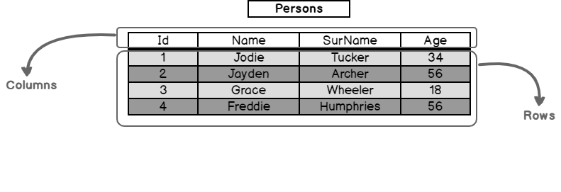
Relational Table
Can be created, dropped, renamed
Consists of rows, columns, keys and indices

Slide 9
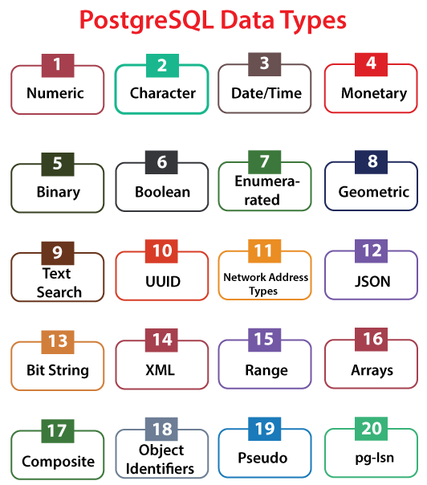
Data Types
https://www.postgresql.org/docs/current/datatype.html

Slide 10
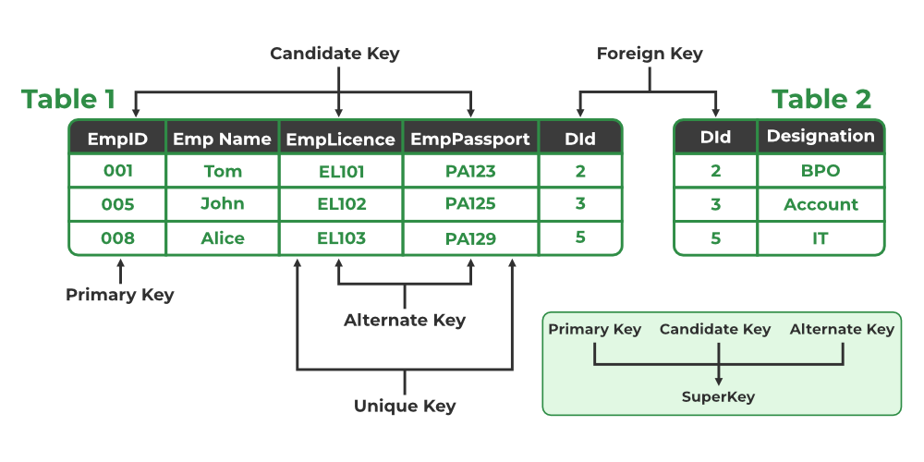
Relational Keys
Primary Key
Foreign Key
Unique Key
Composite Key
Candidate/Alternate Key

Slide 11
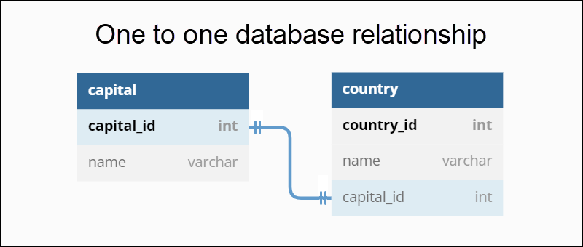
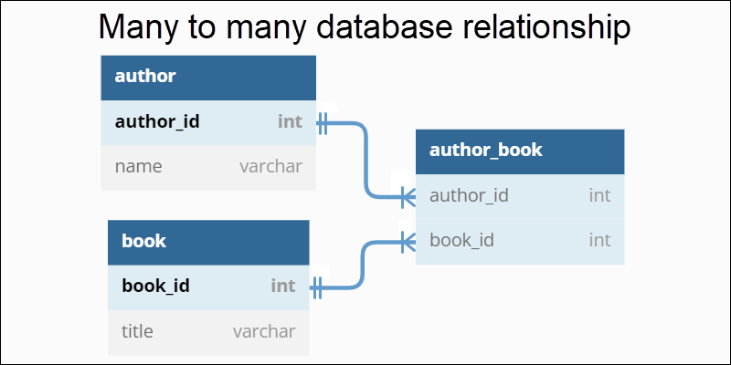
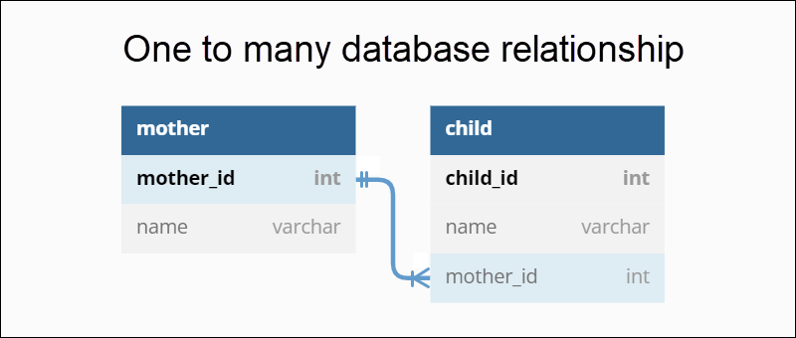
Relationships

Slide 12
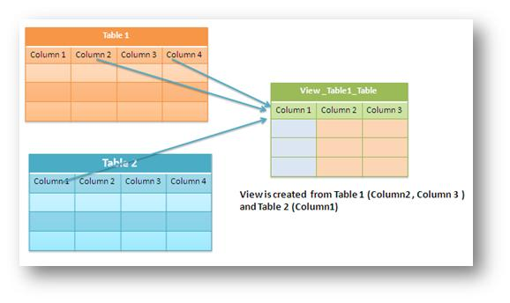
View
Virtual Table
Dynamic Representation
Can be reused

Slide 13
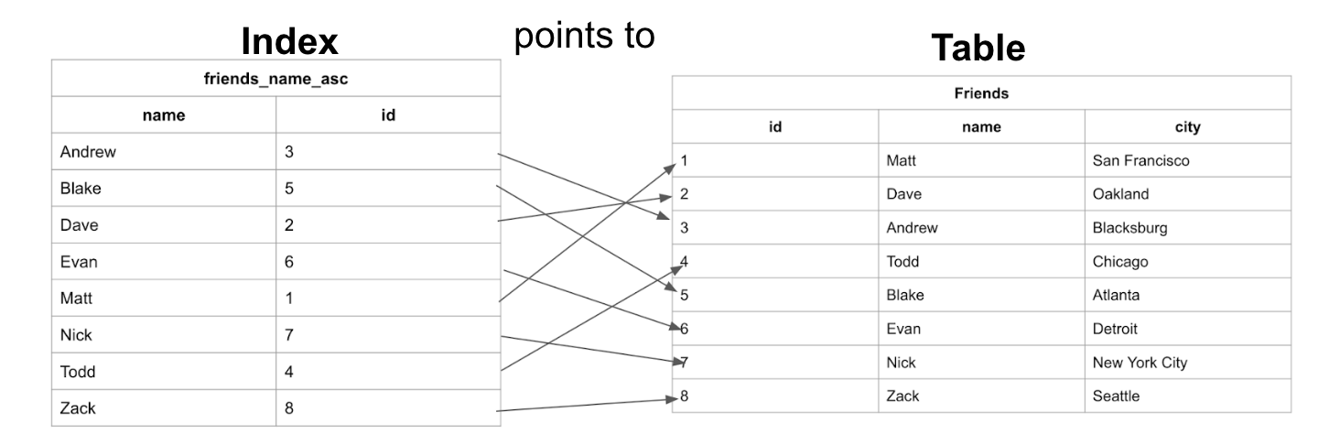
Indices
Sorted structures
Improve search, sorting and access

Slide 14
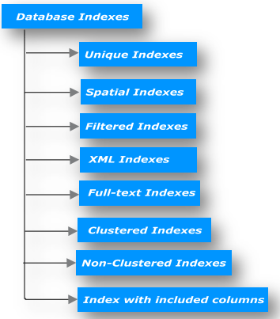
Index Types
Primary Index
Secondary Index
Unique Index
Composite Index
Full-Text Index

Slide 15
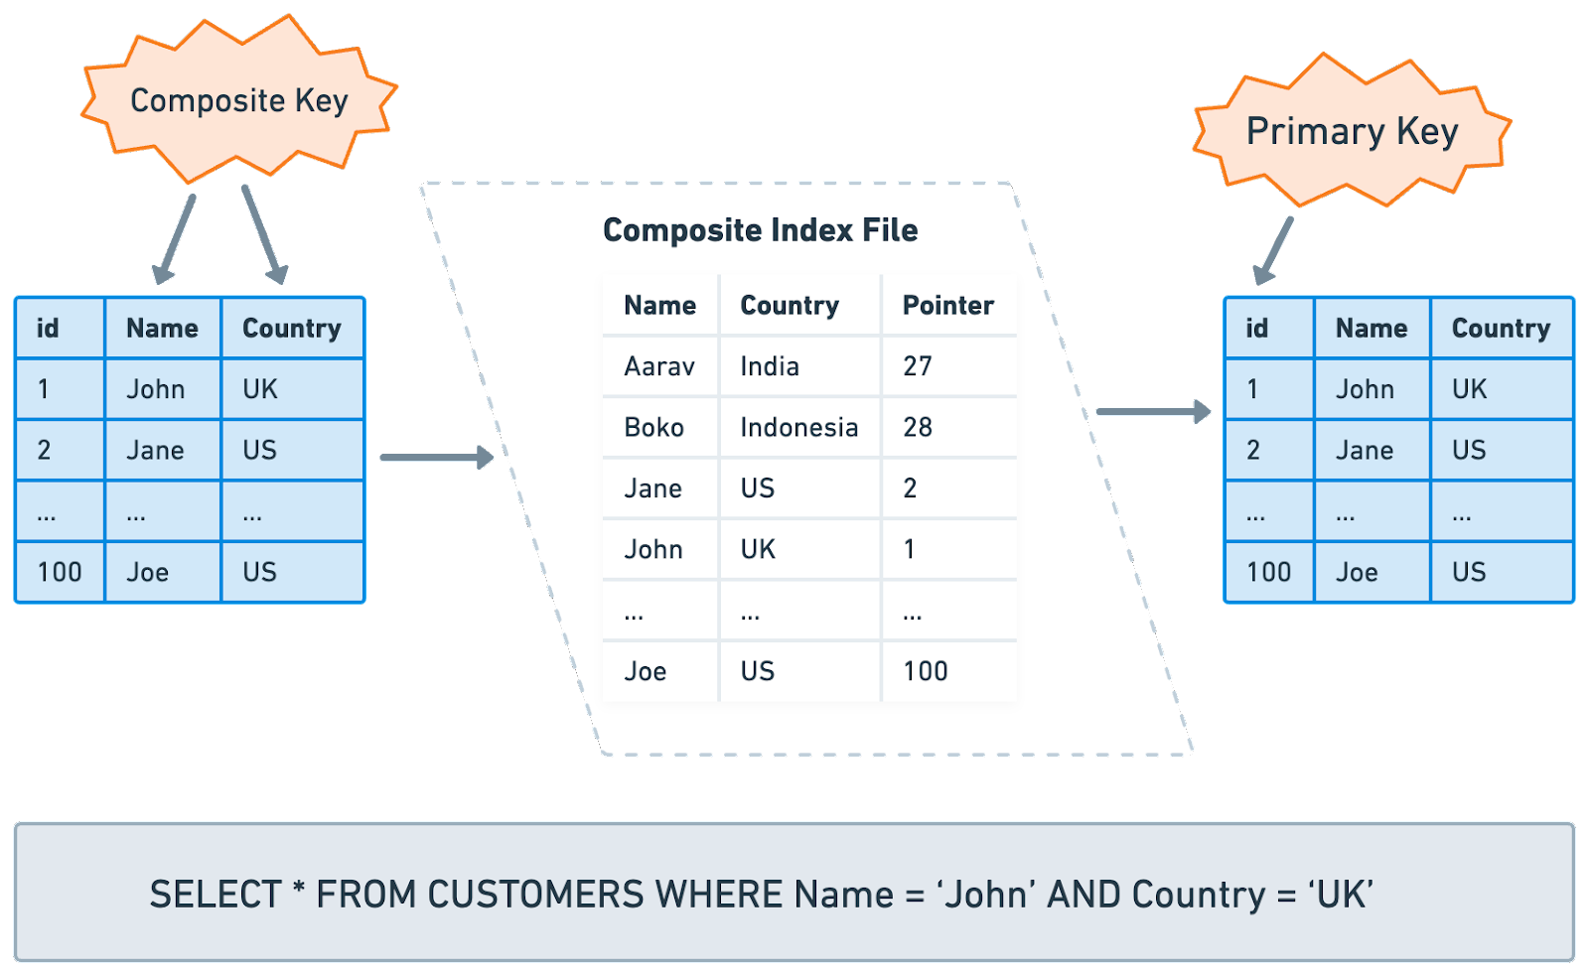
Composite Index
Multi-column index
Column order is significant
Can be unique
Query specific

Slide 16
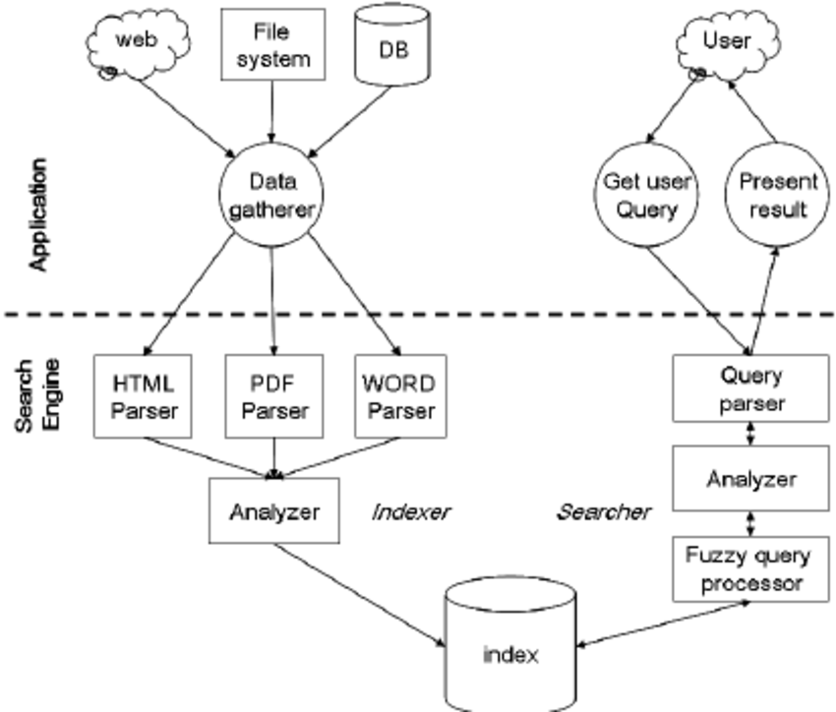
Full-Text Index
Text-based data search
Based on text splitting
Search by keywords/phrases

Slide 17
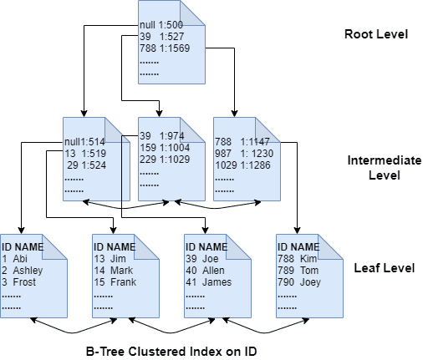
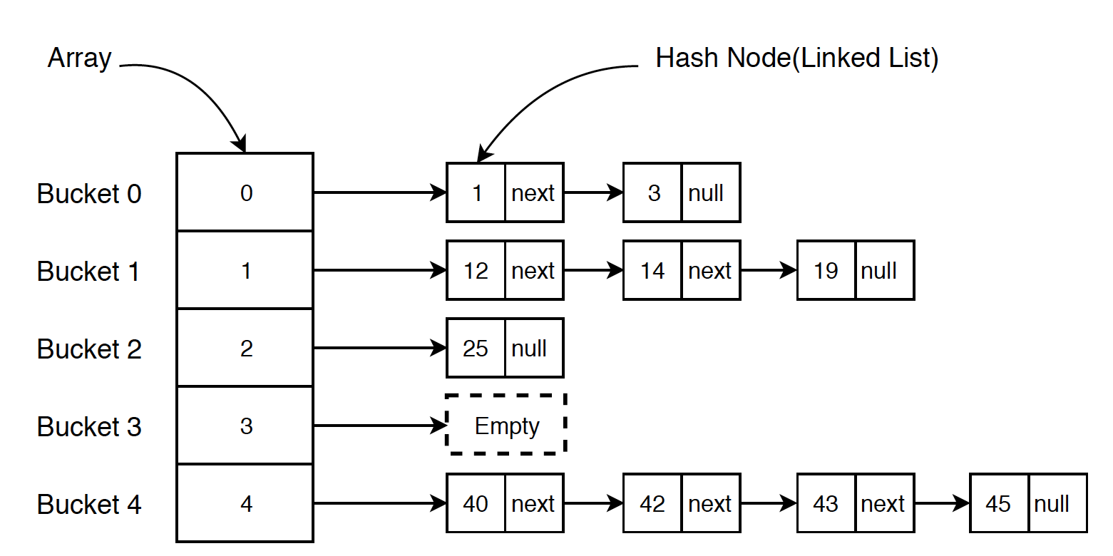
Storage of Indices
Stored separately from data
Can be cached in RAM
Common types:
B-tree
Hash
Bitmap

Slide 18
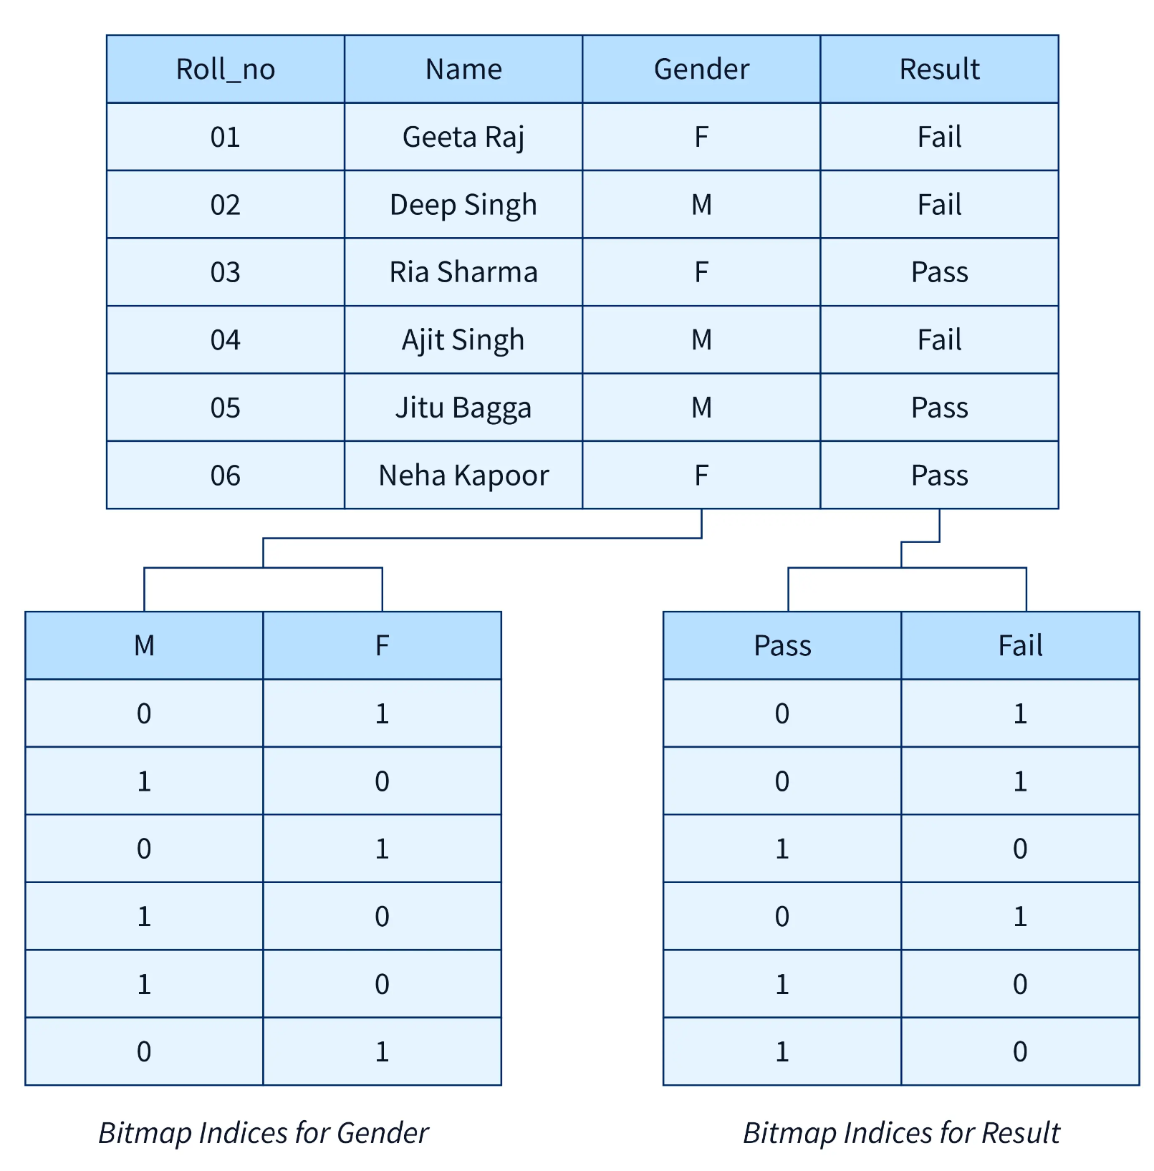
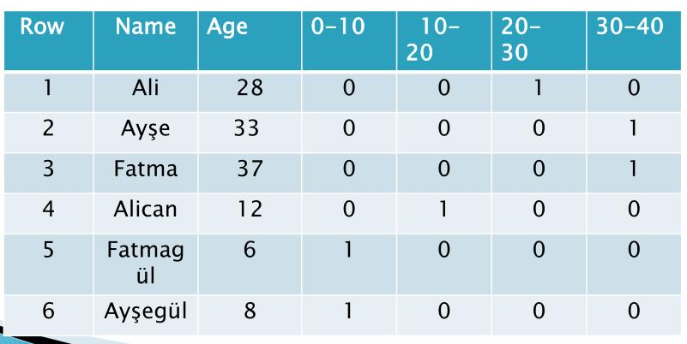
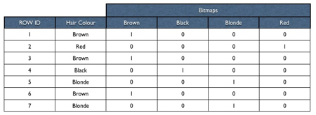
Bitmap Index
Each value has its bit
Efficient with low-cardinality data

Slide 19
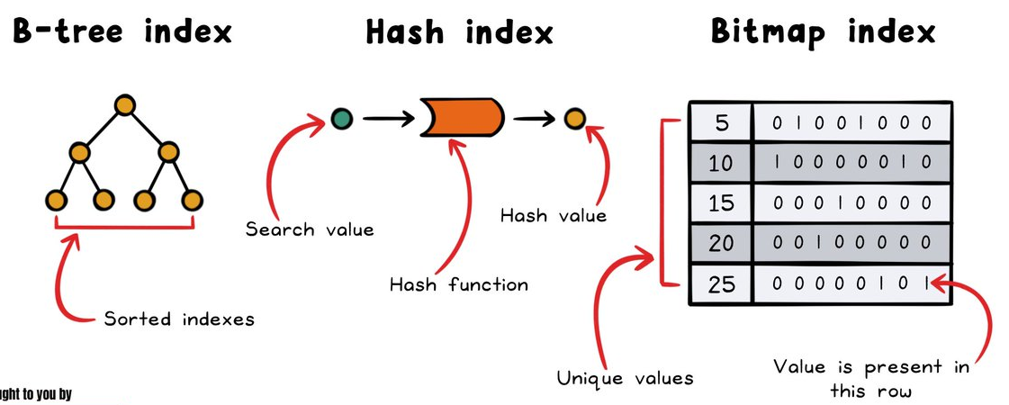
Hash vs B-tree vs Bitmap
Hash Index:
Exact match
More I/O due to collisions
B-tree:
Range query
Order
Minimal I/O due to balanced structure
Bitmap:
Low-cardinality data
Boolean operations
Efficient I/O on low-cardinality

Slide 20
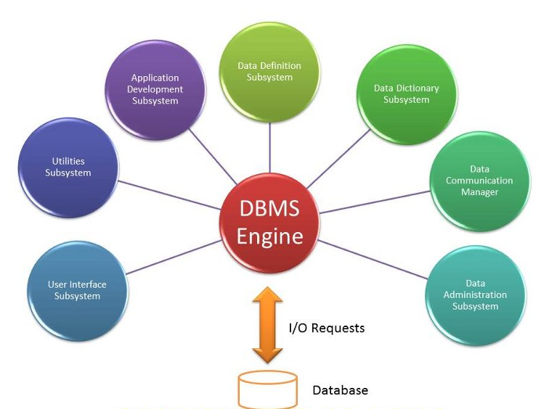
DSL (Domain Specific Language)
SQL (Structured Query Language)
PostgreSQL SQL
MySQL SQL
NoSQL Query Languages
MongoDB query language
Cypher for Neo4j
ORM (Object-Relational Mapping) DSLs
SQLAlchemy for Python
ActiveRecord for Ruby
Sequel for Ruby
Database Definition DSLs
PostgreSQL DDL
MySQL DDL
Data Manipulation DSLs
MapReduce DSL
Hadoop DSL

Slide 21
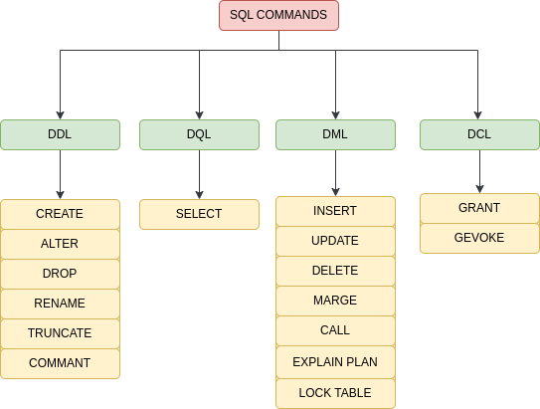
SQL
Data Query Language (DQL)
Data Definition Language (DDL)
Data Manipulation Language (DML)
Data Control Language (DCL)

Slide 22
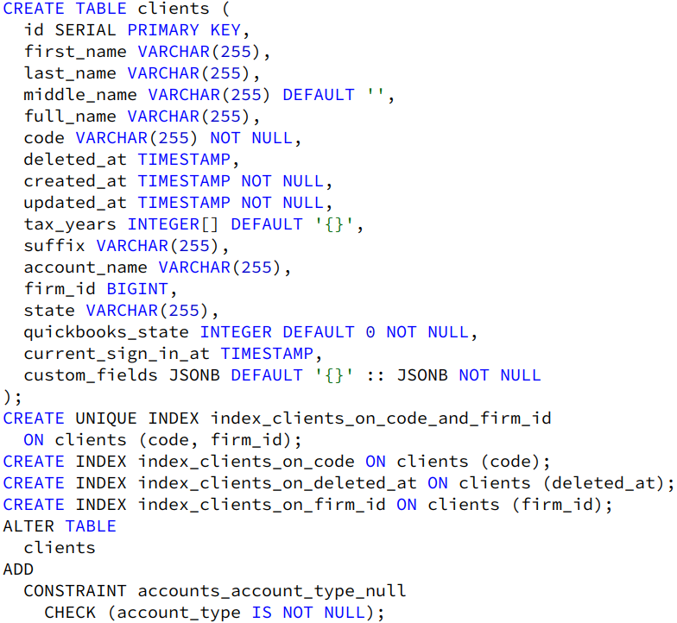
DDL
Common operations:
CREATE
DROP
ALTER
Used to create constraints
Used in database schema management

Slide 23
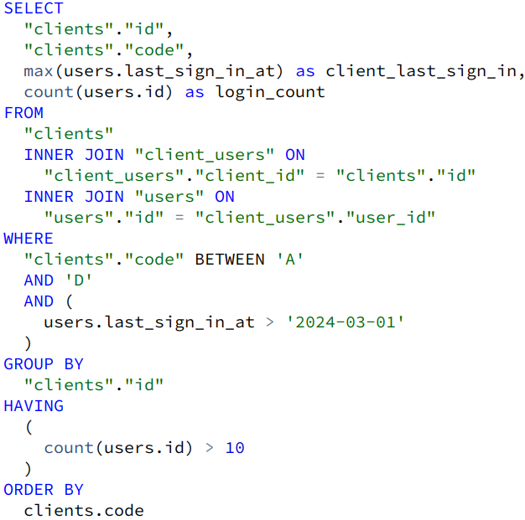
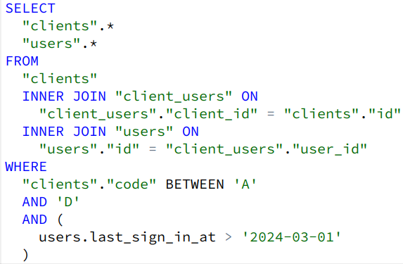
Queries

Slide 24
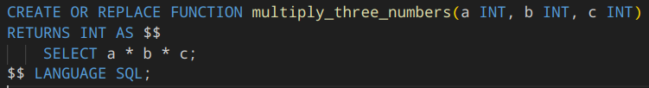
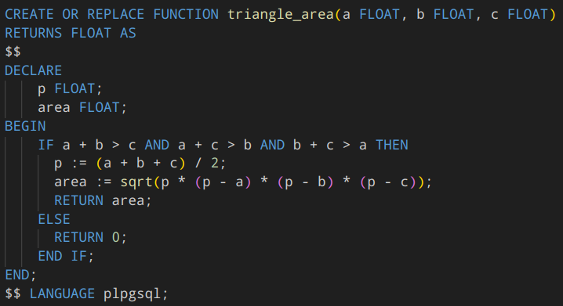
Function
Reusable block of code
Accepts input parameters and returns results
Types:
Scalar Functions
Set-Returning Functions
Aggregate Functions
Languages:
SQL
PL/pgSQL

Slide 25
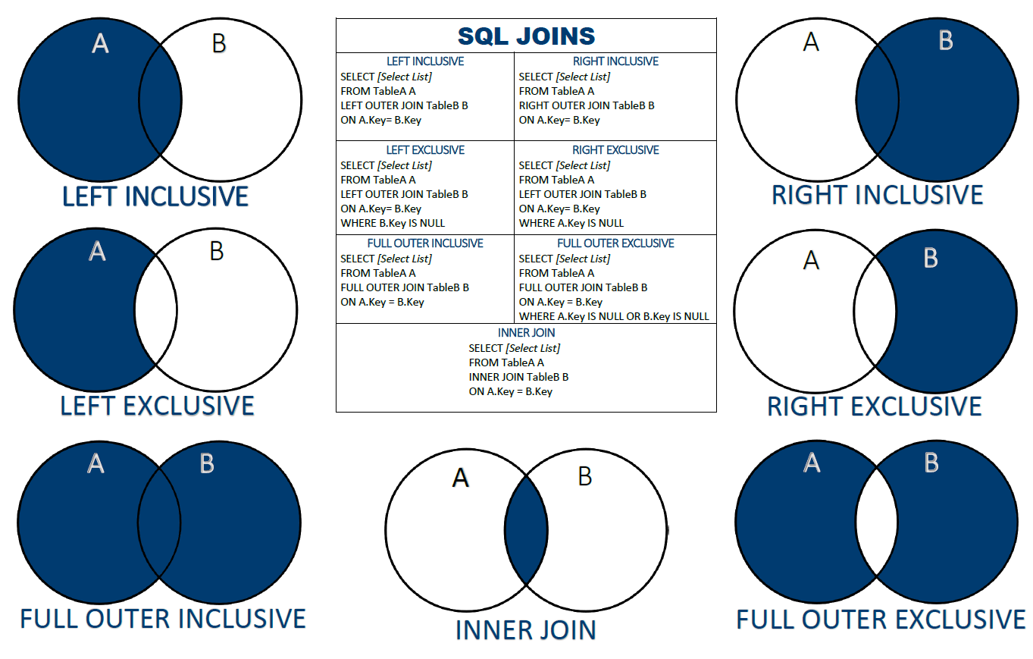
Join
Combines columns from one or more tables
Based on related columns
Types:
Inner Join
Right Join
Left Join
Full Join
Cross Join
Self Join

Slide 26
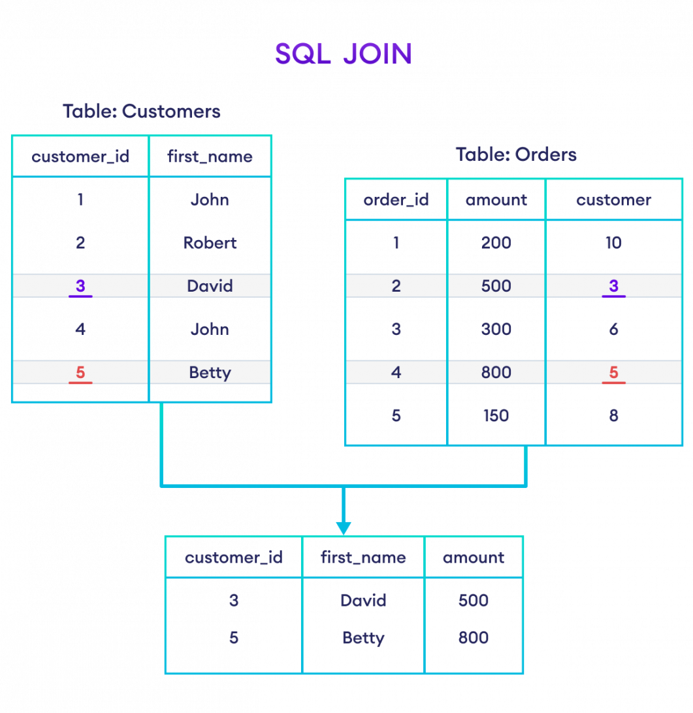
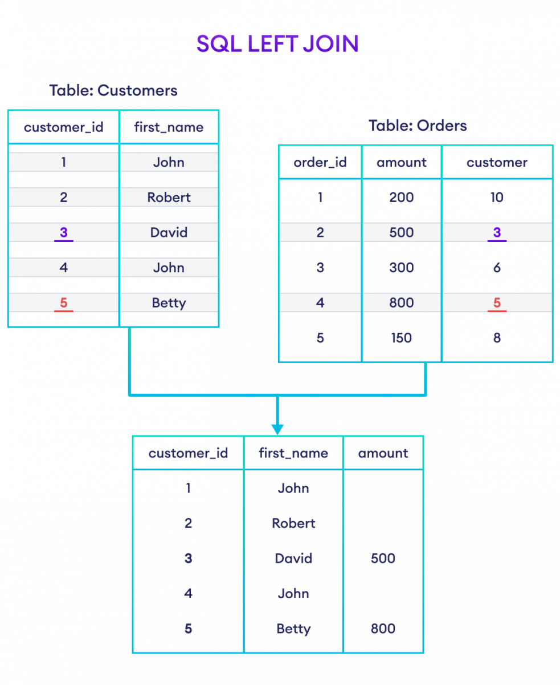
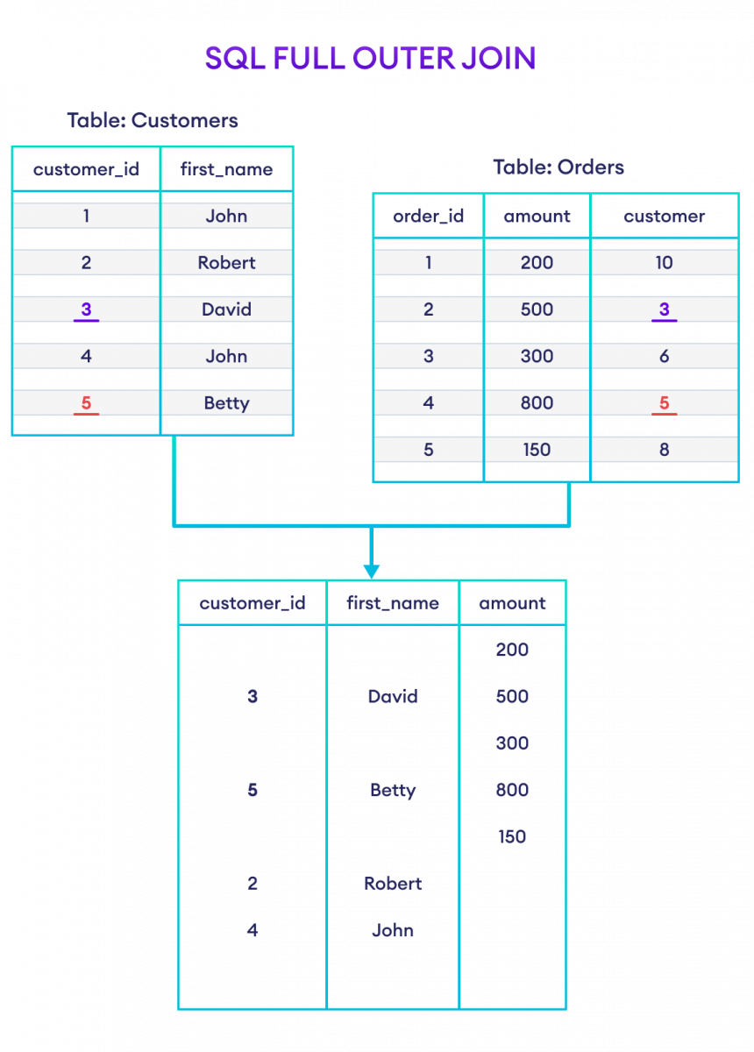
Join

Slide 27
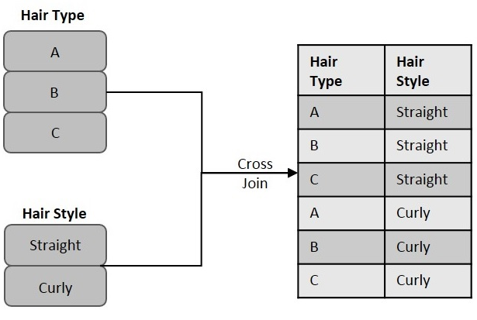
Cross Join
Cartesian product
Generates every possible combination of rows from the joined tables
Can be replaced with an inner join with an always-true condition

Slide 28
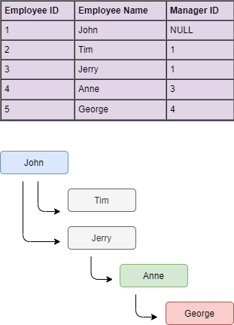
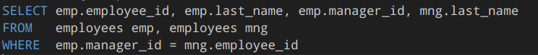
Self Join
Table is joined with itself
Based on a related column
Mostly used to represent hierarchies

Slide 29
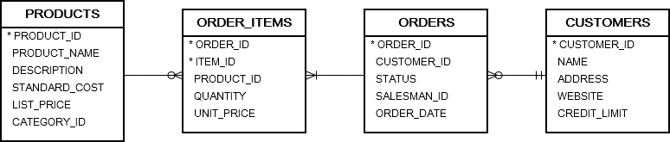
Join Order
Sequence in which tables are joined together
Impacts query performance
Shown in query execution plan
Database query optimizer chooses the most efficient join order
To force the planner to follow the join order laid out by explicit JOINs, set the join_collapse_limit run-time parameter to 1
Join priority:
Smaller tables
Tables with filters
Tables with selective join conditions
Tables with appropriate indexes on join columns

Slide 30
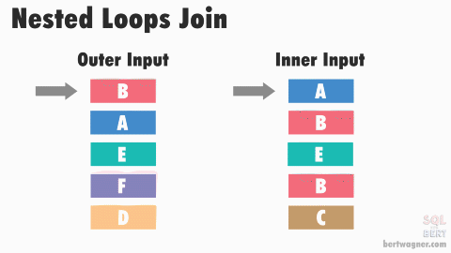
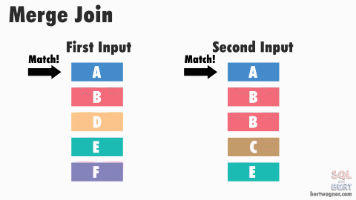
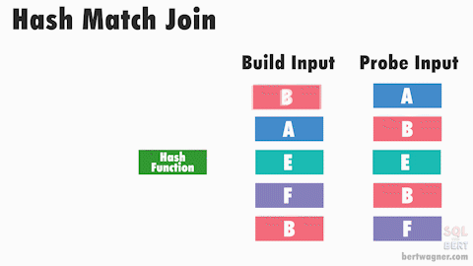
Join Algorithms
Nested Loop Join
For each row scan the entire table
Small tables or on indexed columns
Hash Join
Build hash tables based on the join key and find matches
Large tables and non-indexed join keys
Sort-Merge Join
Sort both input tables based on the join key and merge them
Large tables with indexed join keys

Slide 31
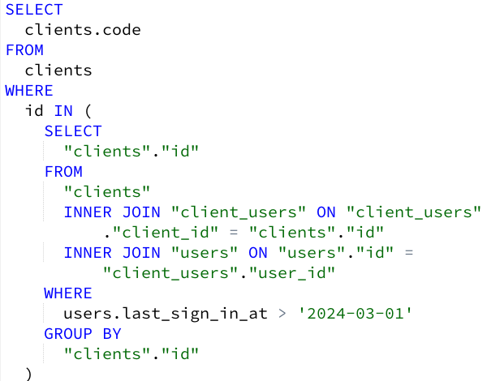
Subqueries
Nested queries
Replaces DISTINCT

Slide 32
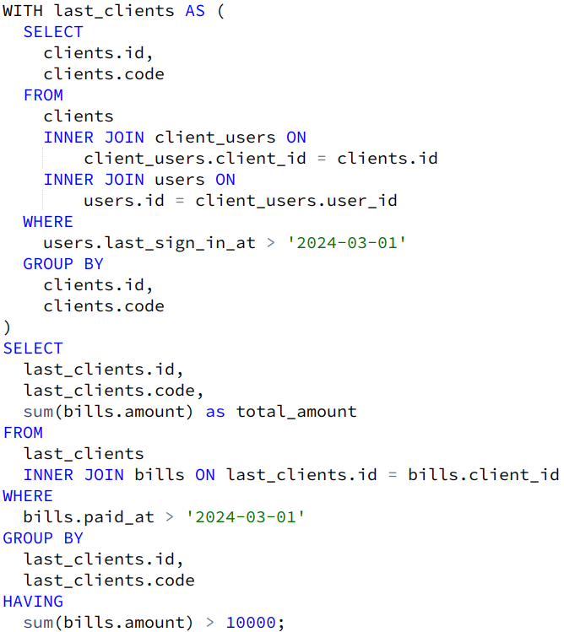
CTE
Improves readability and allows reusability
Performance optimization

Slide 33
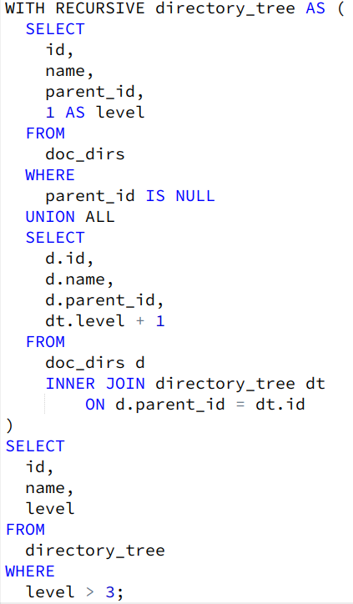
Recursive Queries
Used to access nested data
Used to traverse trees

Slide 34
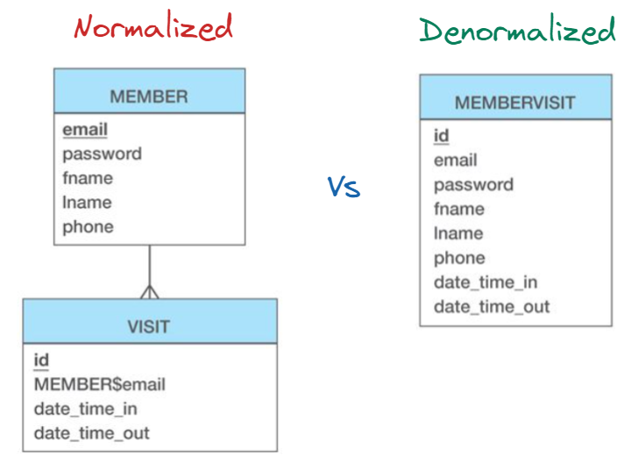
Normalization
Problems:
Data redundancy
Update anomalies
Data inconsistency
Solution:
Normal Forms

Slide 35
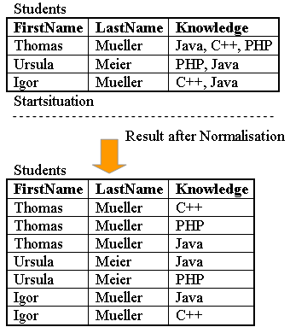
First Normal Form (1NF)
Simple attributes
No repeating groups

Slide 36
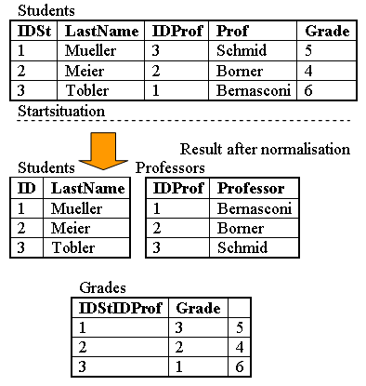
Second Normal Form (2NF)
1NF
Each non-key attribute is dependent on primary key

Slide 37
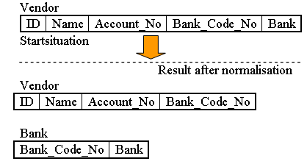
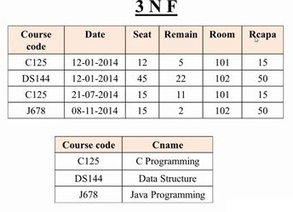
Third Normal Form (3NF)
2NF
Removes transitive dependencies
No non-key attribute is dependent on another non-key attribute

Slide 38

Transactions
Must be completed entirely or not at all

Slide 39
ACID
Atomicity
complete successfully or fail and rollback
Consistency
consistent state before and after execution
Isolation
transactions are isolated from each other
changes are invisible until committed
Durability
once commits its permanent even if system fails

Slide 40


Slide 41


Slide 42


Slide 43


Slide 44

Read Errors and Isolation Levels
Dirty Read
transaction reads uncommitted data
changes rollback
Lost Update
two transactions concurrently read and update same data
one change overwrites another
Non-Repeatable Read
read multiple times data that changes between reads
Phantom Read
transaction reads a set of rows
other transaction inserts rows to same table

Slide 45

Locks
Сontrol access to data during transactions
Preventing conflicting operations
Types:
Shared Lock (S) - blocks writing
Exclusive Lock (X) - blocks reading and writing
Update Lock (U) - blocks writing, can block reading
Schema Locks - access control

Slide 46

Deadlocks
Problem:
Multiple transactions waiting to release a lock cause by
concurrent transactions
circular dependencies
inadequate locking strategies
Solution:
Detection:
Timeout Mechanisms
Deadlock Detection Algorithms
Resolving:
Prevention
Avoidance
Resolution

Slide 47

Scalability
Vertical vs Horizontal
Strategies:
Sharding
Replication
Partitioning
Caching
Can improve performance
Can lower consistency
Harder maintenance

Slide 48

Partitioning
Dividing a large database table into smaller partitions
Division is done by keys
Types:
Range Partitioning
List Partitioning
Hash Partitioning

Slide 49

Sharding
Dividing a large database into smaller
Each shard is hosted on a separate database server
Types:
Horizontal Sharding
Vertical Sharding
Key-Based Sharding

Slide 50

Replication
Creating copies (replicas) of a database
Master-Slave Replication
Can be asynchronous or synchronous
Can be full or partial

Slide 51

Caching
Caching is the process of storing frequently accessed data in memory
Types:
Query Result Caching
Object Caching

Slide 52

PostgreSQL
ACID Compliance
Extensibility
Data Integrity
Built-in Scalability
Replication
JSON and NoSQL Support
Full Text Search
Security
SSL/TLS encryption
Role-based access control
Row-level security

Slide 53

NoSQL
NoSQL (Not Only SQL) - non-relational databases
Designed to handle large volumes of unstructured or semi-structured data
Not suited for complex queries
Weak persistence
Basic transactions

Slide 54

SQL vs NoSQL

Slide 55

Key-Value Databases
Collection of key-value pairs
Unique keys
High read and write throughput
Scales horizontally
Use cases:
Caching
Session Management
Shared Memory
Real-time Analytics

Slide 56


Redis
Key-value database
Stored in RAM
Supports data structures
Persistence strategies
Supports clustering
Supports pub/sub messaging
Supports atomic operations with Lua

Slide 57

S3
Amazon S3 (Simple Storage Service) - object storage service
Key-value database
Can store virtually unlimited data
Designed for 99.999999999% (11 nines) durability
Supports object versioning
Clustered

Slide 58

Column-Oriented Databases
Store and query data by column rather than by row
Best at aggregating operations
Efficient compression and encoding
Bulk loading data is efficient
Single operations are slower
Horizontal Scalability
Suited for analytics

Slide 59

Document Databases
Store data in semi-structured format known as documents
Flexible evolving shemas
JSON native, support nested structures
Horizontal Scalability
Support indexing
Supports links (like relations)
Can support complex queries
Can support ACID transactions
Suited for unstructured data

Slide 60


Graph Databases
Store data as graphs, consisting of nodes, edges, and properties
Relationships between nodes are first-class citizens
Properties add flexibility to the data model
Horizontal Scalability
Suited for highly interconnected data

Slide 61

Distributed Databases
Store large volumes of data across multiple servers
Scale horizontally by adding more nodes
Replicate data to ensure fault tolerance and data durability
Distribute data across nodes to achieve load balancing and efficient query processing
Provide global reach
Data partitioning can be problematic
Consistency vs Availability
Can lead to high latency
Suited for the highest level scaling

Slide 62

Thank you for your attention!

